Slide 1



Mass Mail Dispatcher
-Yash Kumar-

Slide 2


Introduction

Slide 3


Introduction
A mass mail dispatcher is a utility to send a single mail to a large number of recipients simultaneously.
It is designed to take the recipients' list from a csv file.

Slide 4







Tech Stack
HTML
CSS
JavaScript
EmailJS

Slide 5


Screenshots

Slide 6
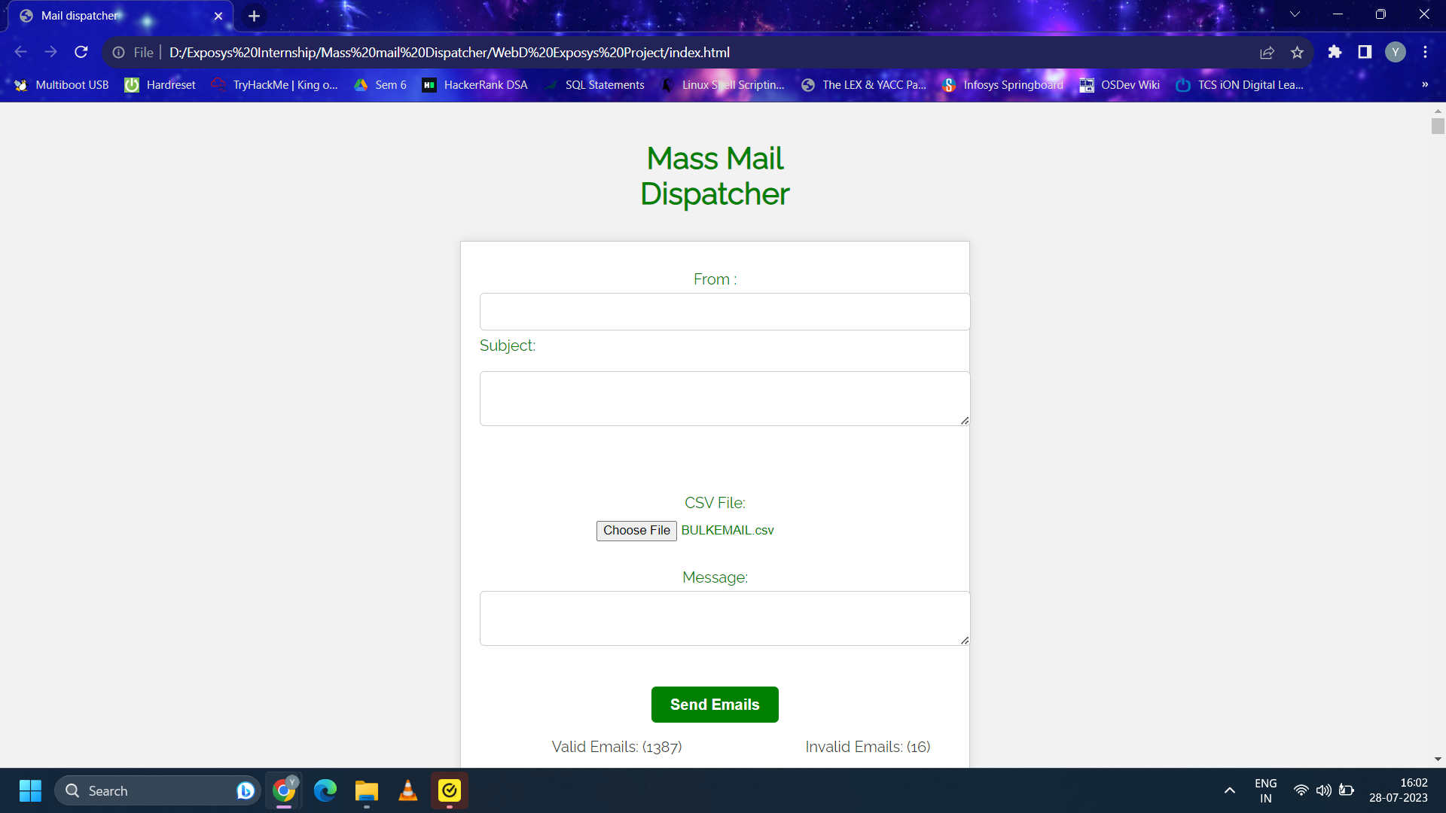

Slide 7
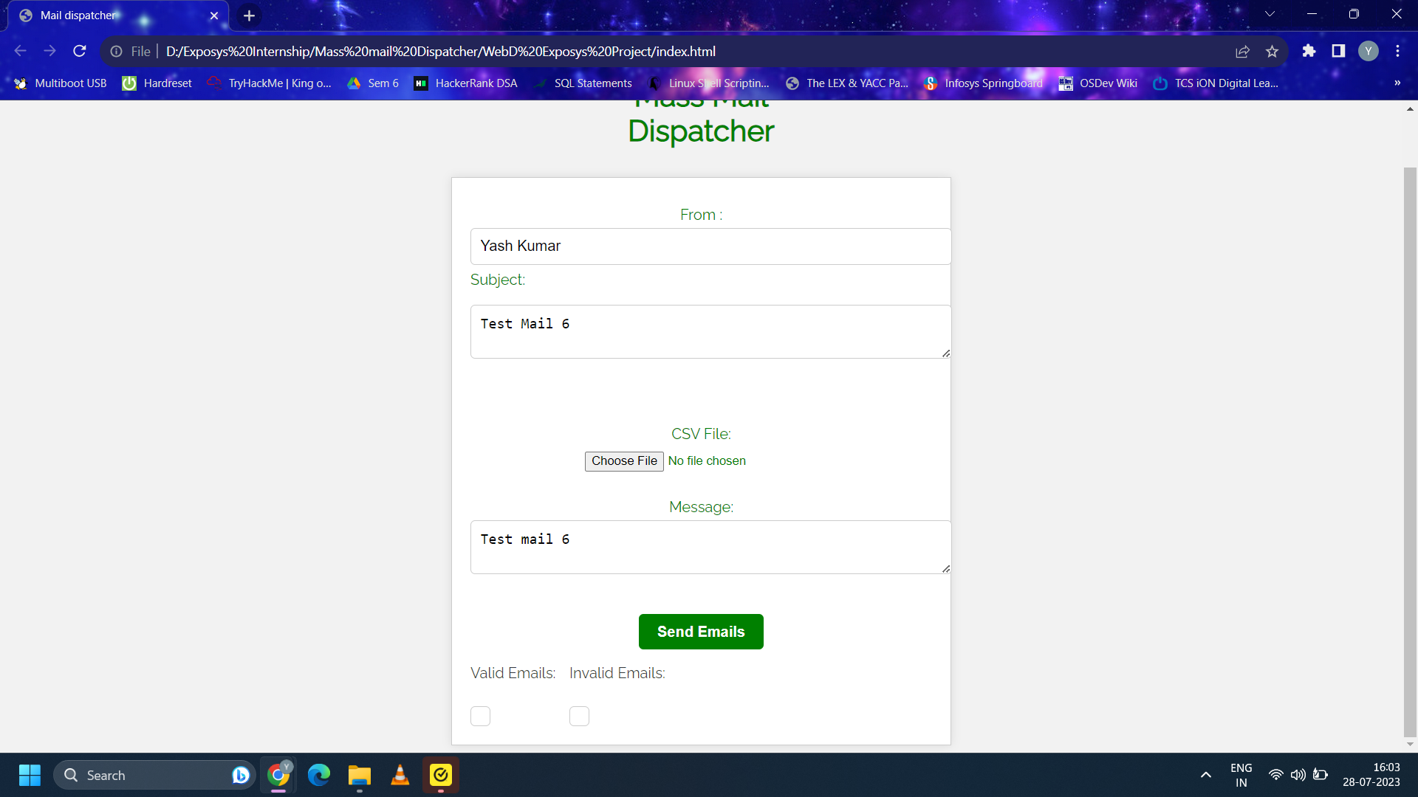

Slide 8
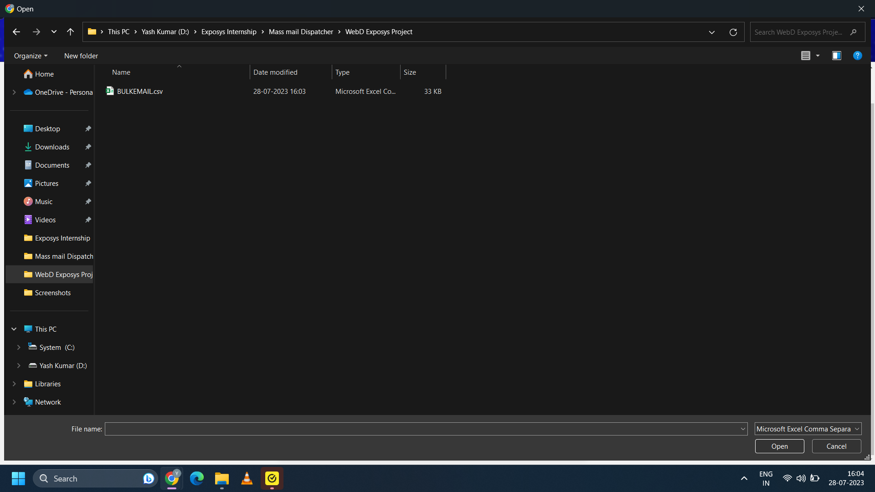

Slide 9
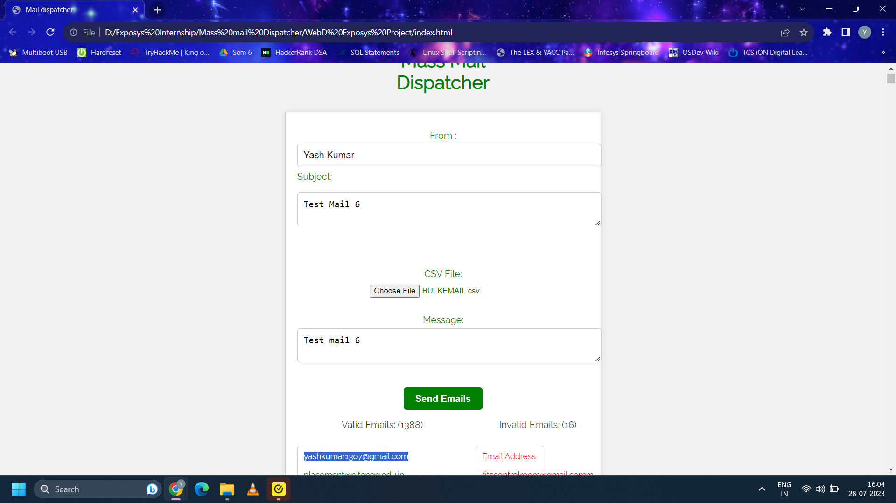

Slide 10
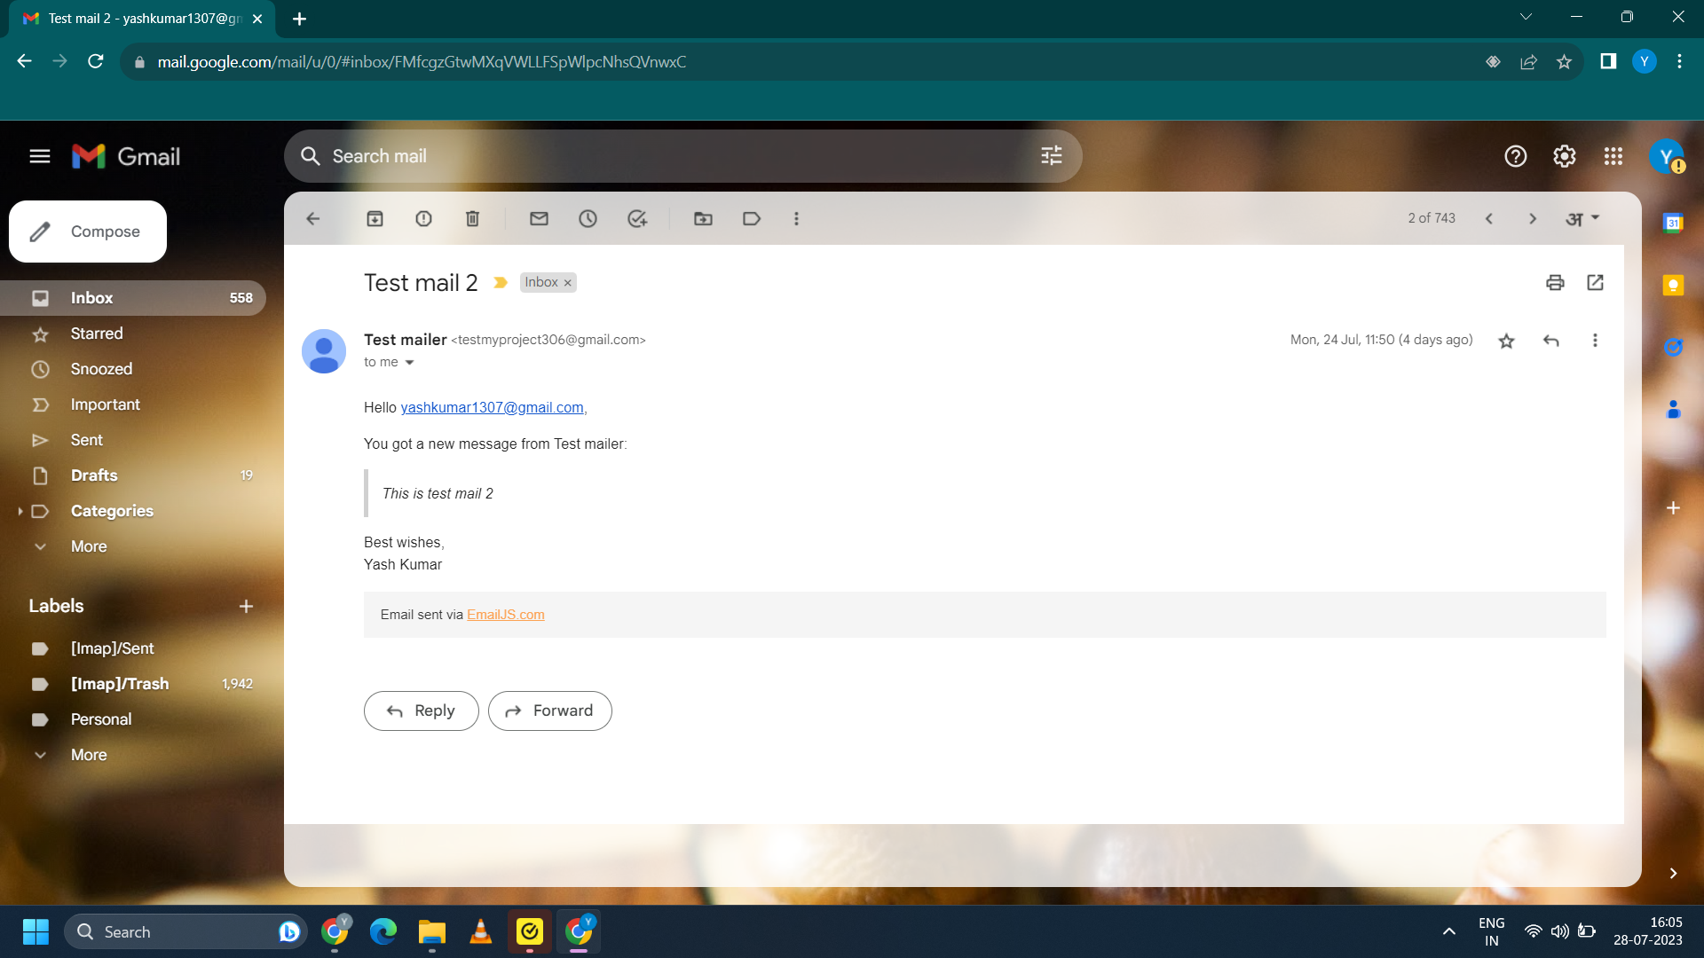

Slide 11

The End

Slide 12
Thank
you

